Slide 1




Stock Price Prediction and Portfolio Optimization Using Recurrent Neural Networks and Autoencoders
https://github.com/QUER01/FinanceModule
Julian Quernheim
Senior Consultant, BIVAL GmbH
https://www.linkedin.com/in/julianquernheim/
https://www.bival.de/en/jobs/

Slide 2
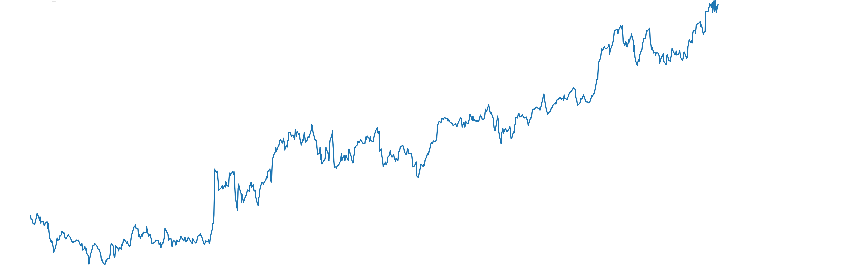
Introduction
Goal:
Apply deep learning to beat traditional portfolio optimization methods.
Problem Statements:
Calculating an optimal stock portfolio allocation still uses historic stock returns.
Risk is quantified without capturing non-linearities of the timeseries.
Requirements:
A basic knowledge of deep learning and portfolio management is required.

Slide 3
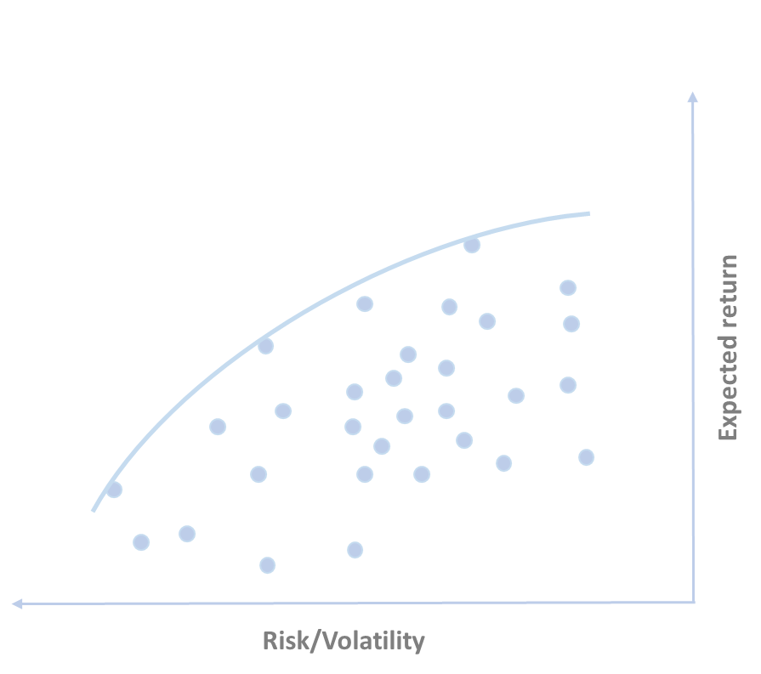
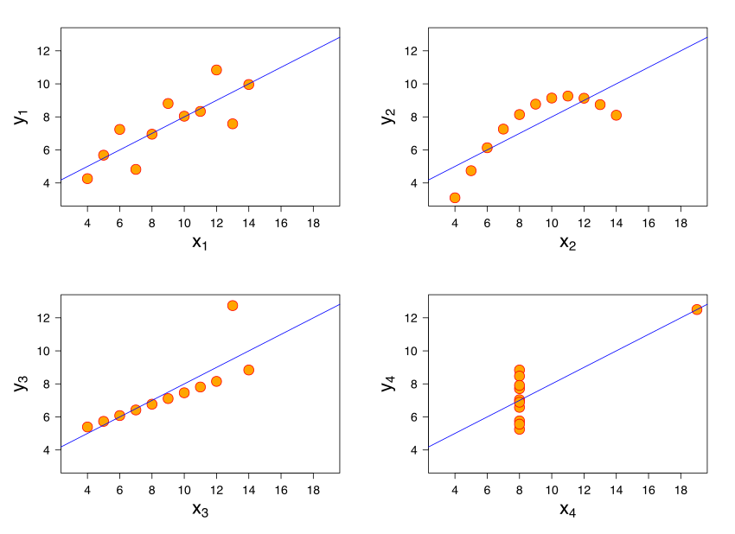
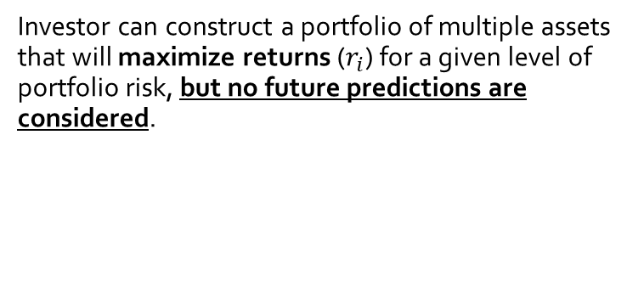
Introduction
Problem statements explained : What is wrong with how we calculate expected returns and risks?
Investor can construct a portfolio of multiple assets that will maximize returns ($r_{i}$) for a given level of portfolio risk, but no future predictions are considered.
The covariance indicates a linear relationship between two variables. Hence it can be fallacious in situations where two variables have a relationship, but it is nonlinear.
Anscombe's quartet: All four sets are identical when examined using simple summary statistics but vary considerably when graphed.

Slide 4
Introduction
Additionally, it is difficult capturing non-linearities of the timeseries when quantifying risk.
The covariance indicates a linear relationship between two variables. Hence it can be fallacious in situations where two variables have a relationship, but it is nonlinear.
Anscombe's quartet: All four sets are identical when examined using simple summary statistics but vary considerably when graphed.

Slide 5





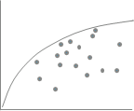

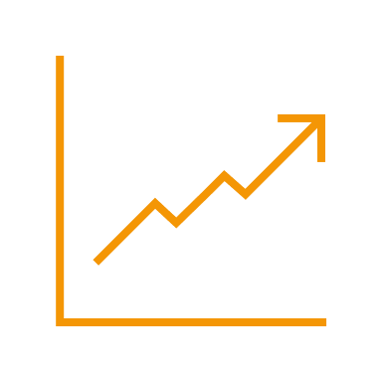
Introduction
Four steps to calculate your portfolio: Focus, forecast, clean and optimize.
Focus: Which stocks to analyze? Focus on stocks that move the market to decrease computation time!
Forecast: Does forecasting improve the portfolio? Don’t forecast too far. A forecast is only a strong indicator.
Clean: How to improve the risk calculation of a stock? Try to capture non-linearities in the time series.
Optimize: How to calculate an optimal portfolio? Don’t trust the in-sample results. Look at the out-of-sample results.

Slide 6
Literature Review

Slide 7
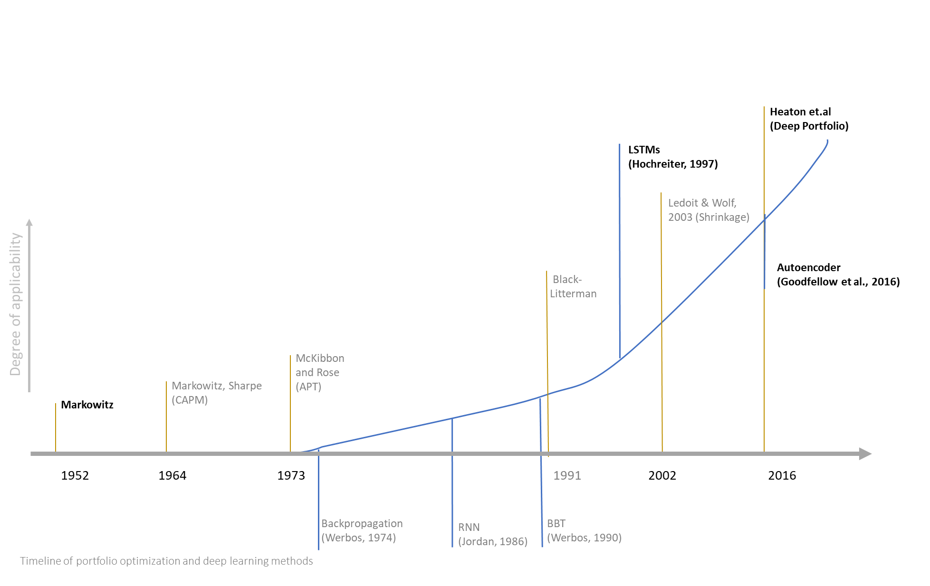
Literature Review
Timeline of deep learning methods
Heaton et.al
(Deep Portfolio)
LSTMs
(Hochreiter, 1997)
Degree of applicability
Ledoit & Wolf,
2003 (Shrinkage)
Autoencoder
(Goodfellow et al., 2016)
Black-
Litterman
McKibbon
and Rose
(APT)
Markowitz, Sharpe (CAPM)
Markowitz
1952
1964
1973
1991
2002
2016
Backpropagation (Werbos, 1974)
RNN
(Jordan, 1986)
BBT
(Werbos, 1990)
Timeline of portfolio optimization and deep learning methods

Slide 8
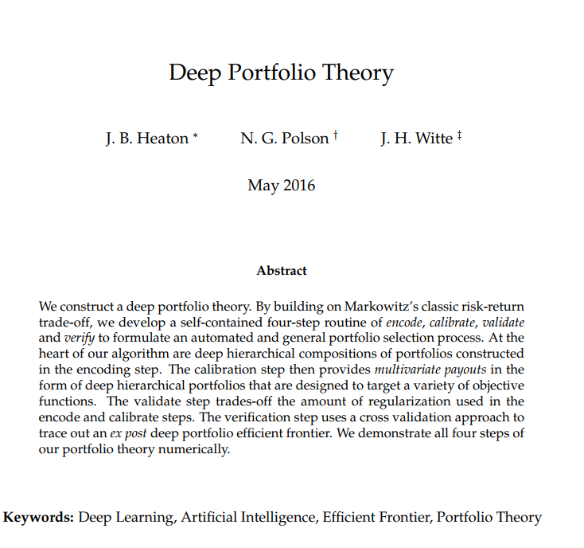
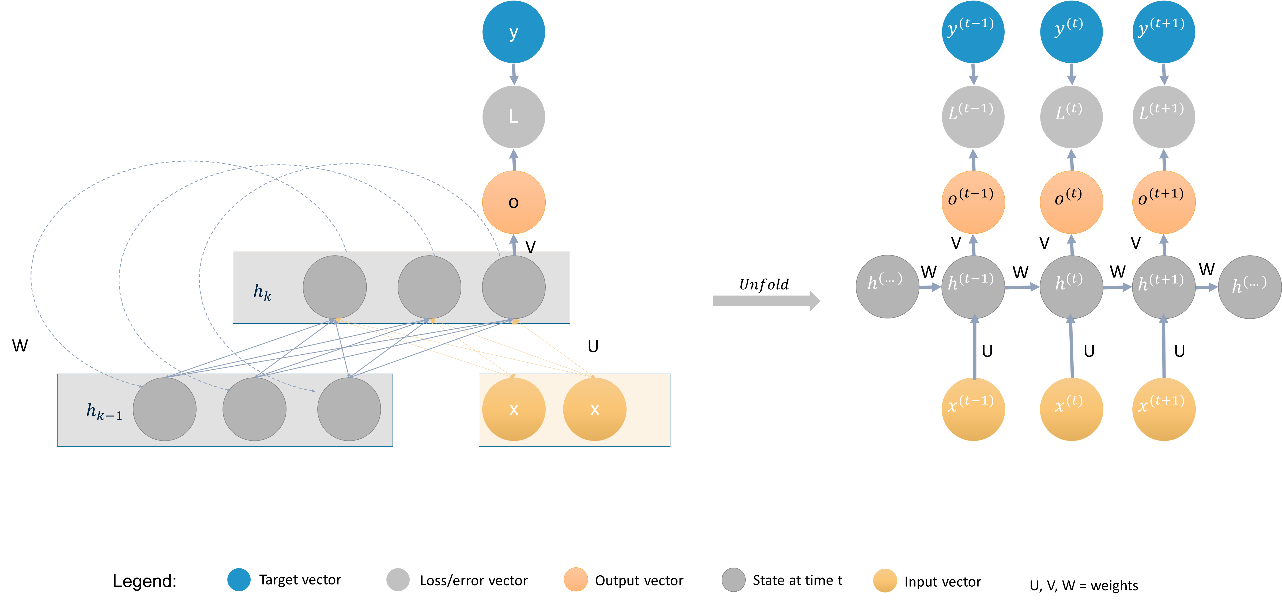
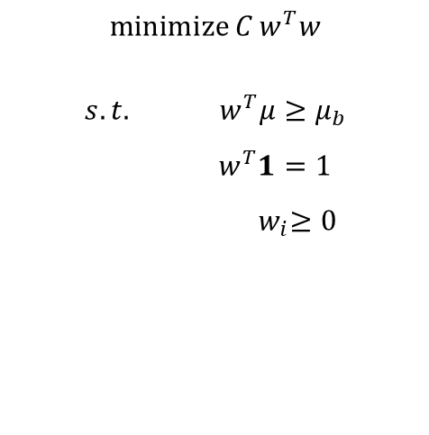
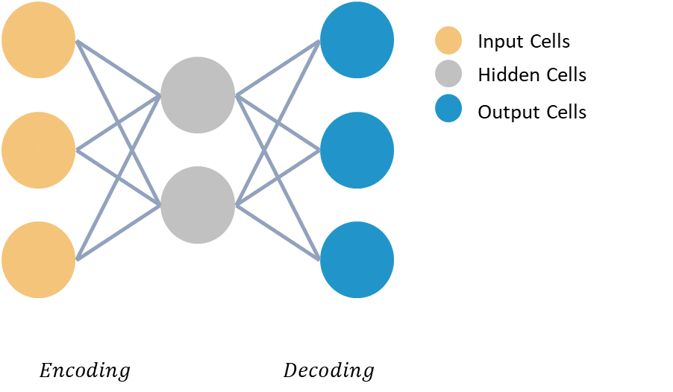
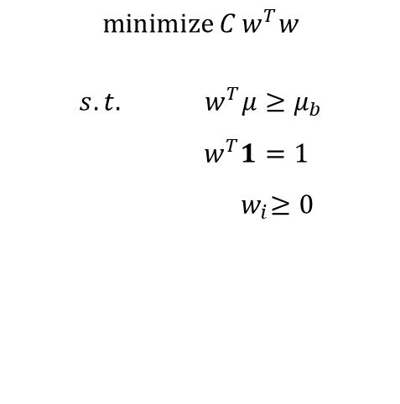
Literature Review
A short recap of what you probably already know!
Portfolio Optimization (Markowitz, 1952)
LSTMs ( RNNs) (Hochreiter, 1997)
Autoencoders (Goodfellow et al., 2016 )
Deep Portfolio (Heaton et. al 2016)
$$\operatorname{minimize}{C}w^{T}w$$
$$s.t.{ w}^{T}μ≥μ_{b}$$
$$w^{T}1=1$$
$${ w}_{i}≥0$$

Slide 9

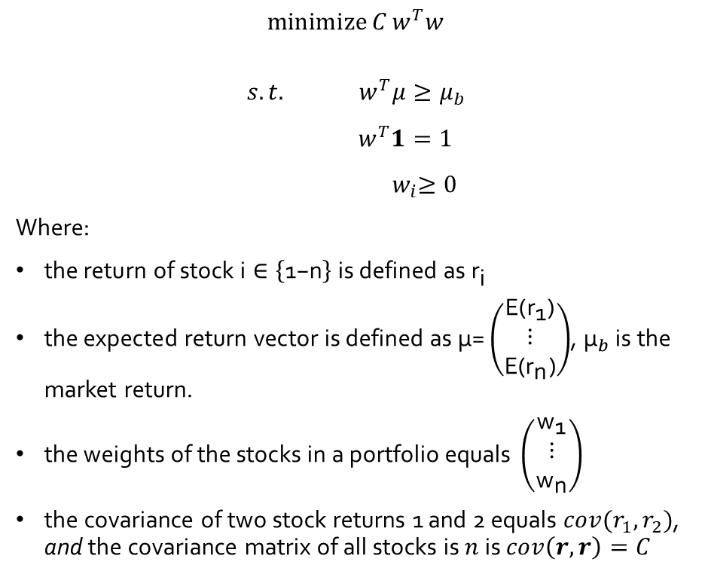
Literature Review
Modern portfolio theory (MPT) (Markowitz, 1952)
$$\operatorname{minimize}{C}w^{T}w$$
$$s.t.{ w}^{T}μ≥μ_{b}$$
$$w^{T}1=1$$
$${ w}_{i}≥0$$
Where:
$\text{the} \text{return} \text{of} \text{stock} \text{i}∈\left\{\text{1−}\text{n}\right\} \text{is} \text{defined} \text{as}{ \text{r}}_{\text{i}}$
$\text{the} \text{expected} \text{return} \text{vector} \text{is} \text{defined} \text{as} \text{μ}\text{=}\left(\begin{matrix}\text{E}\text{(}{\text{r}}_{\text{1}}\text{)} \\ \text{⋮} \\ \text{E}\text{(}{\text{r}}_{\text{n}}\text{)}\end{matrix}\right)$, ${\text{μ}}_{b}$ is the market return.
$\text{the} \text{weights} \text{of} \text{the} \text{stocks} \text{in} \text{a} \text{portfolio} \text{equals} \left(\begin{matrix}{\text{w}}_{\text{1}} \\ \text{⋮} \\ {\text{w}}_{\text{n}}\end{matrix}\right)$
the covariance of two stock returns 1 and 2 equals $cov(r_{1},r_{2})$, and the covariance matrix of all stocks is $n$ is $cov\left(r,r\right)=C$
Source: https://medium.com/datadriveninvestor/simple-portfolio-optimization-harry-markowitz-mean-variance-model-using-excel-part-1-efc3f19a347

Slide 10
Literature Review
How do Recurrent neural networks work?
Recurrent neural networks (RNNs) process sequential data.
Each state of the RNN is therefore a function depending on its previous states.
An example of a folded and unfolded RNN.

Slide 11
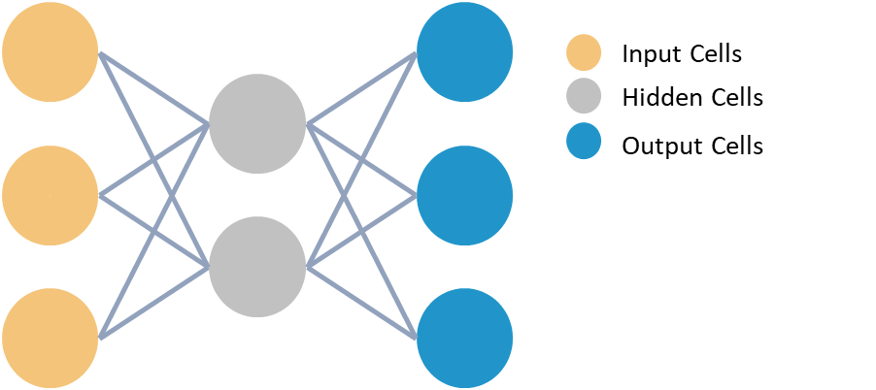
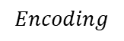
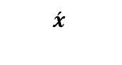
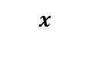
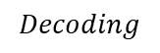
Literature Review
What are Autoencoders?
$$x$$
z
$$\acute{x}$$
An autoencoder is an unsupervised neural network that is trained to attempt to copy its input to its output [Goodfellow et al., 2016].
Autoencoders are used for:
dimensionality reduction
removing structural noise
feature learning
outlier detection
$$Encoding$$
$$Decoding$$
An example of a folded and unfolded RNN.
Example of an undercomplete autoencoder with three input and output layers and two hidden layers.

Slide 12
Data, Methodology & Results

Slide 13
Data, Methodology & Results
Focus, forecast, clean and optimize.
→ Autoencoder, LSTMs, Shrinkage Estimator and Linear Optimization
→ Apply an autoencoder model and filter stocks that can be recreated best.
→ Forecast the next 10-days of a stock closing value into the future using Recurrent Neural networks.
→ Apply latent features of an autoencoder model to clean the sample covariance matrix.
→Apply linear portfolio optimization and find the optimal stocks for the portfolio by optimizing the sharpe ratio.

Slide 14
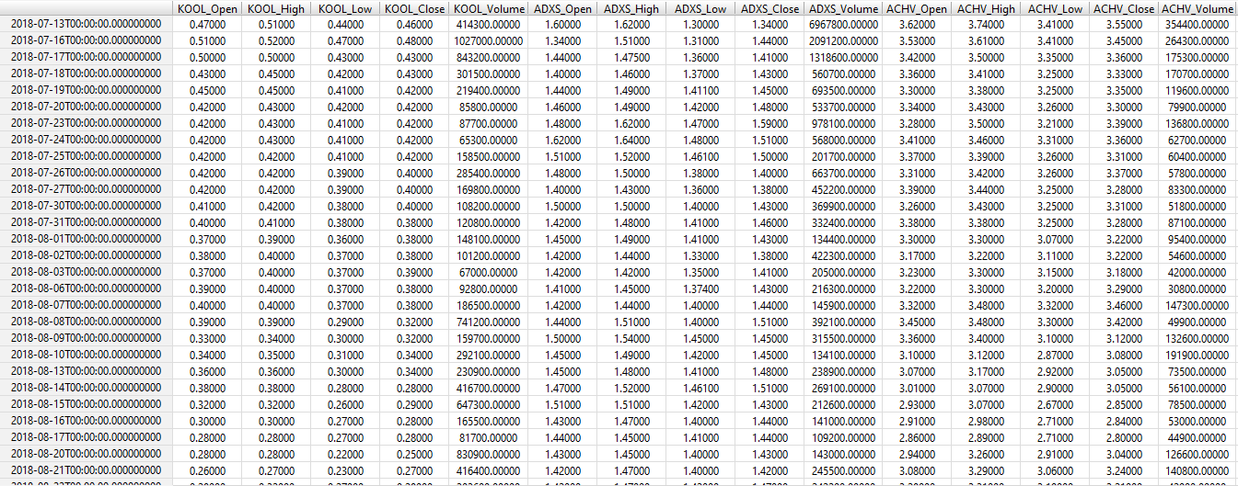
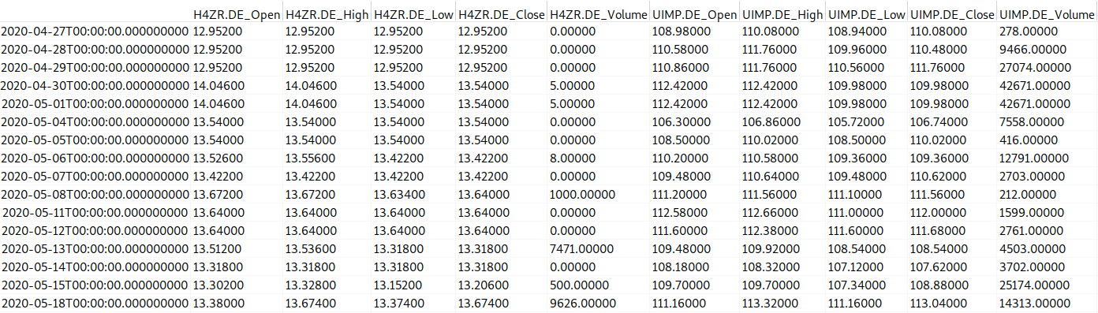
Datasets
Dateset 1 (only stocks):
Stock exchanges: NYSE and NASDAQ
Tickers: 5685 (only stocks)
Range: 2014 -2018
Final dataset: [1000 rows x 13925 columns]
Dateset 2 (only ETFs):
Stock exchanges: Frankfurt
Tickers: 1098
Range: 2020-current
Final dataset: [1000 rows x 4318 columns]
Transformed stock datasets

Slide 15
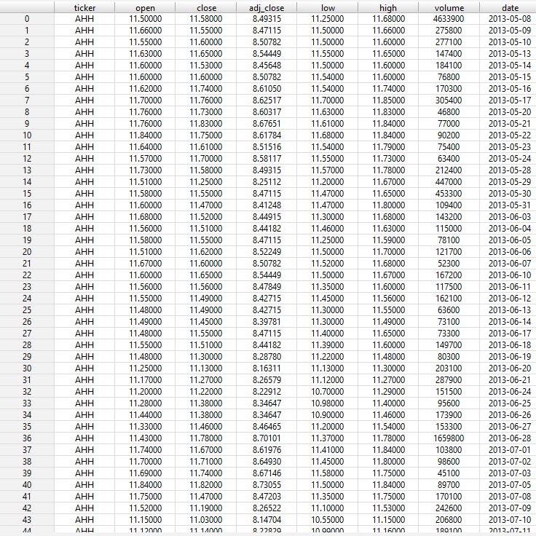
Dataset
Dataset: daily-historical-stock-prices-1970-2018
Source: Kaggle
Stock exchanges NYSE and NASDAQ
Dataset dimension: [20973889 rows x 8 columns]
Tickers: 5685
Original stock dataset

Slide 16
Dataset
Selected last 1000 days from 2014 -2018
Transformed each ticker into columns
Final dataset: [1000 rows x 13925 columns]
Transformed stock dataset

Slide 17
Focus: Which stocks to analyze?
1
Focus on stocks that move the market!
s1
…
S_n
t1
0.3
0.2
0.1
0.1
0.3
0.2
Intuition:
The stocks with the lowest recreation error (L2-norm) represent the market better. They are less volatile and are considered to be similar to large cap stocks.
0.4
0.1
-2
0.3
0.4
Returns
0.1
Returns
Input Cells
Hidden Cells
Output Cells
t_n
Top 1000 stocks / 200 ETFs
Calculate L2-Norm and select best recreated stocks
Autoencoder model with ranked recreation error.

Slide 18
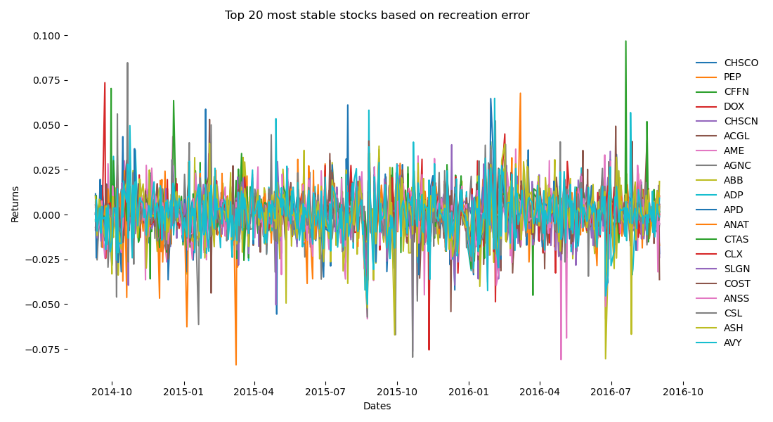
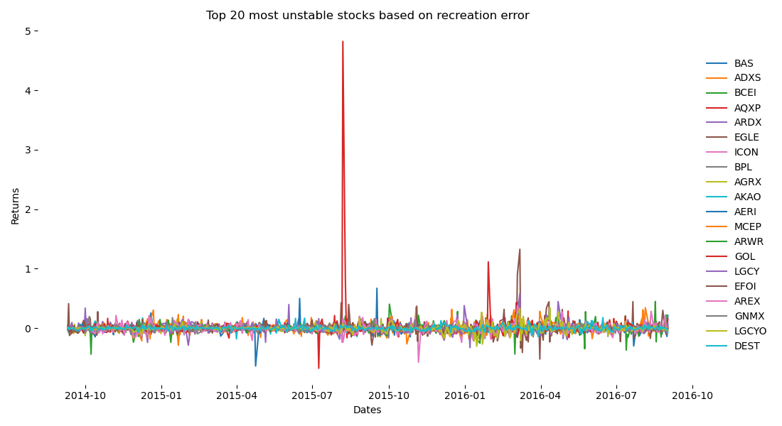
Focus: Which stocks to analyze?
1
Unstable stocks tend to be more volatile and have more unexpected spikes!
Top 20 most stable and most unstable stocks ranked by recreation error.

Slide 19
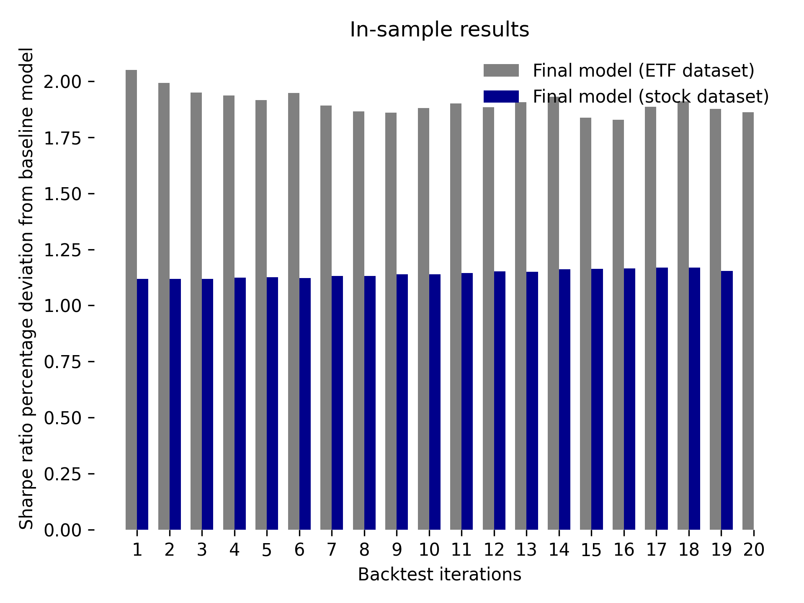
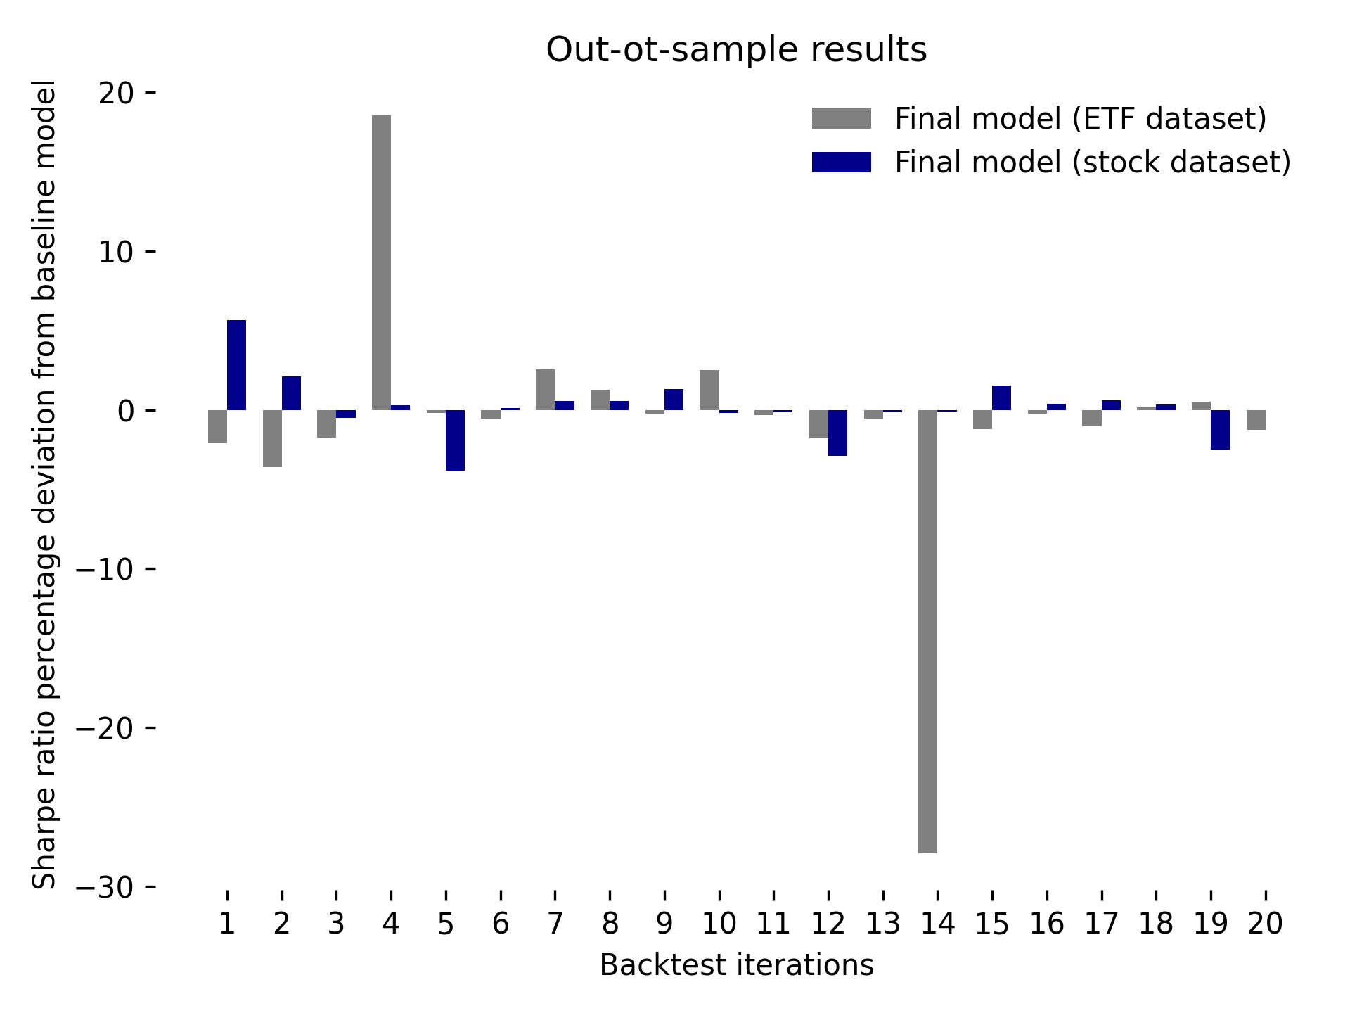
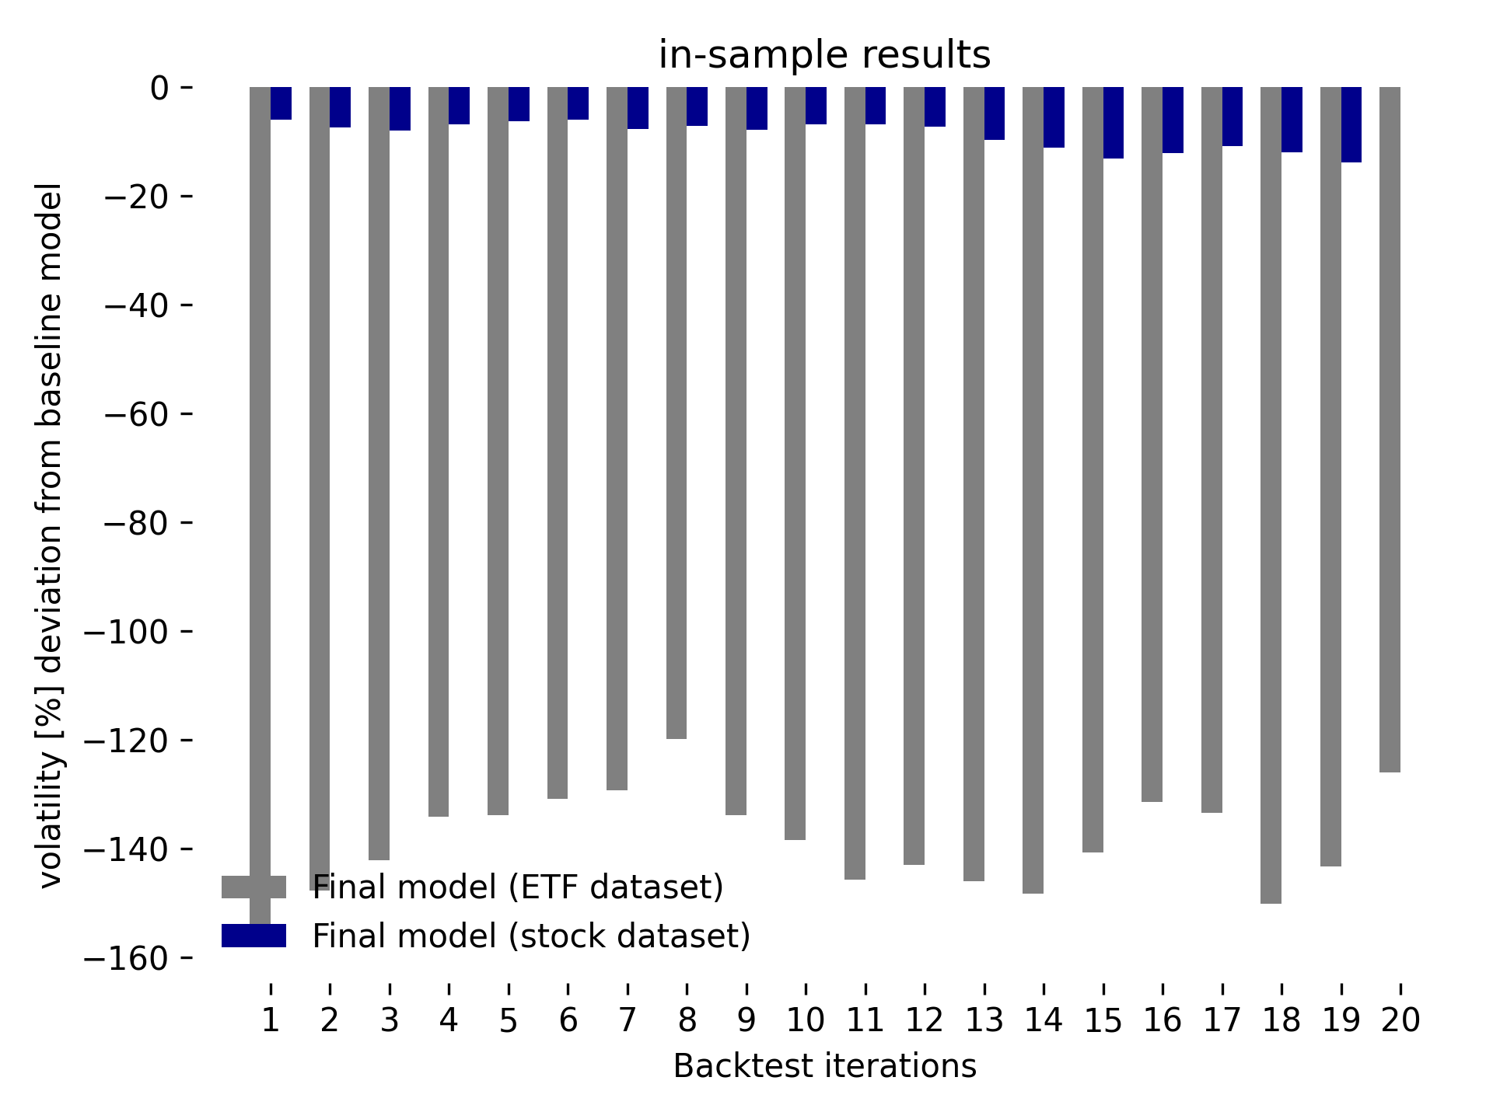
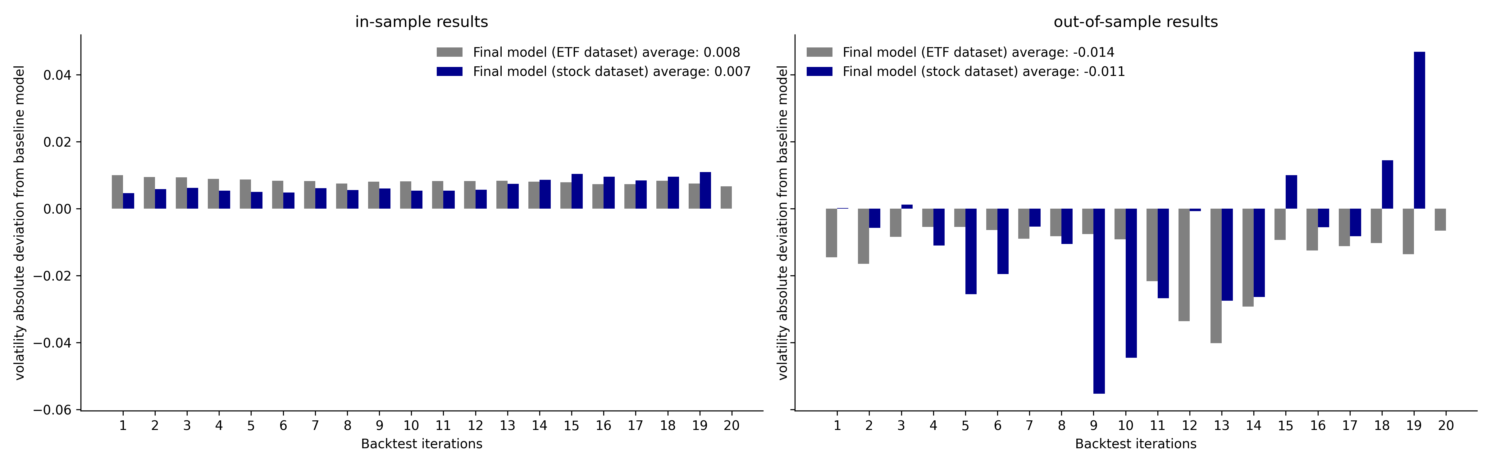
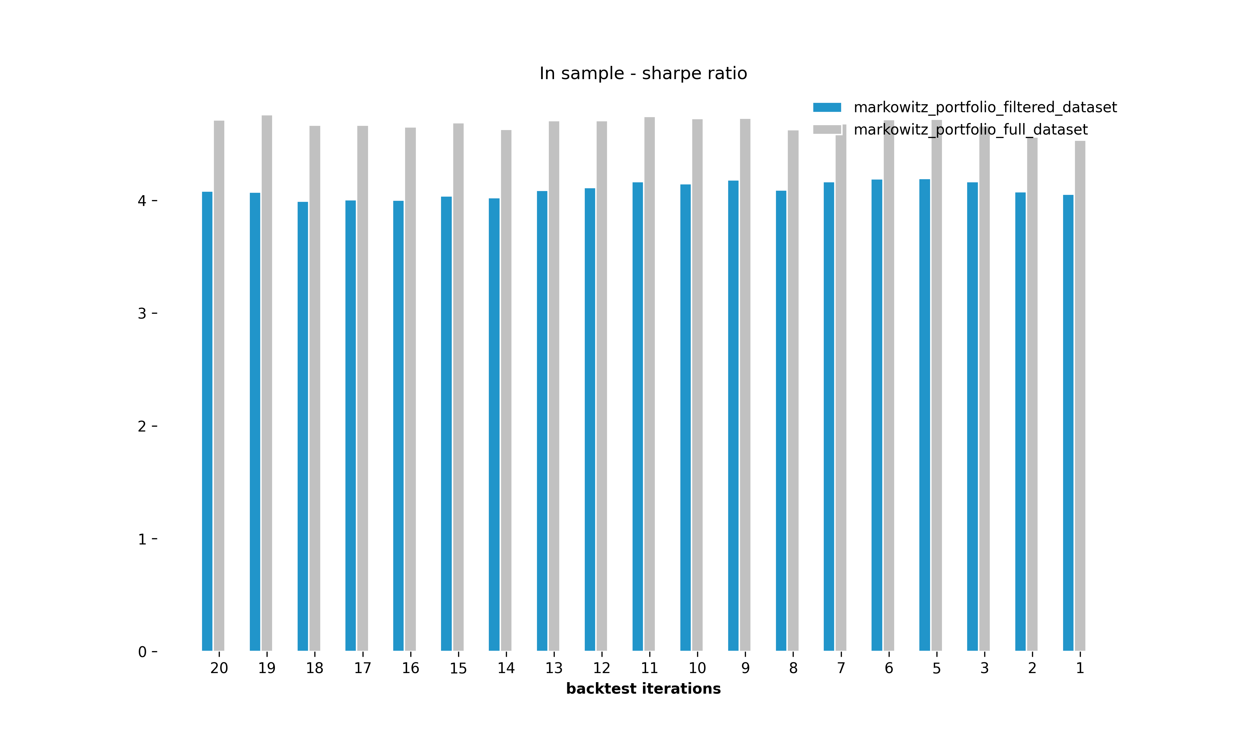
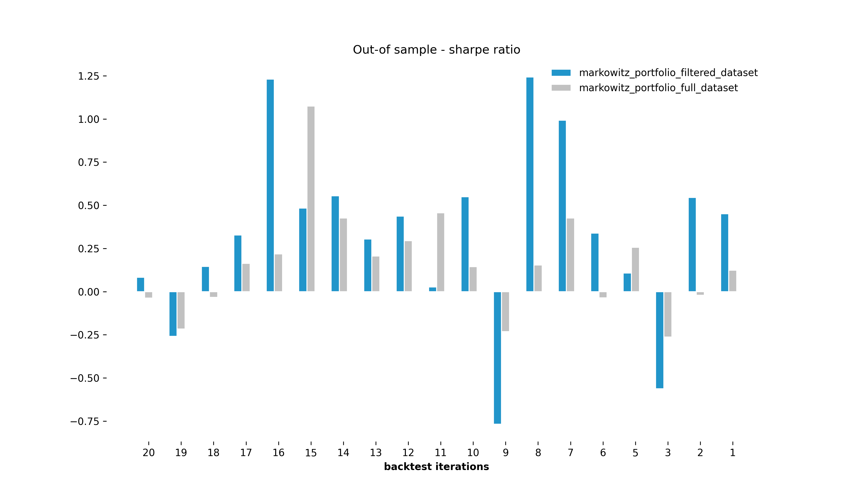
Focus: Which stocks to analyze?
1
Filtering based on recreation error decreases out-of sample volatility!
In-sample and out-of-sample volatility deviation for ETFS and stocks
baseline = full dataset
challenger = filtered dataset

Slide 20
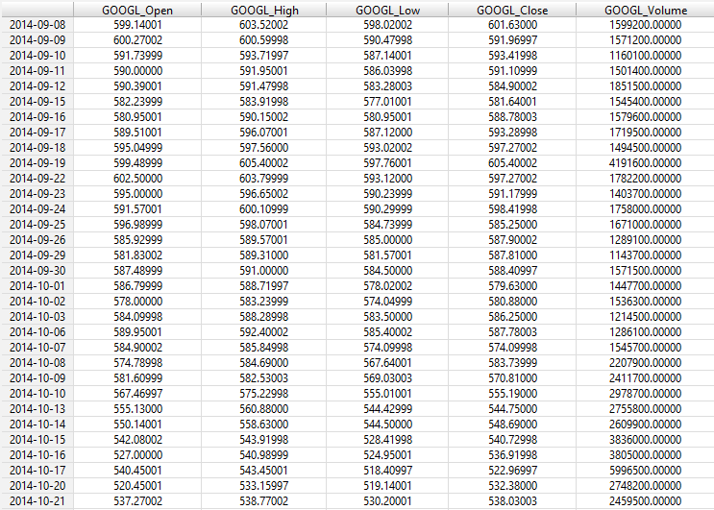
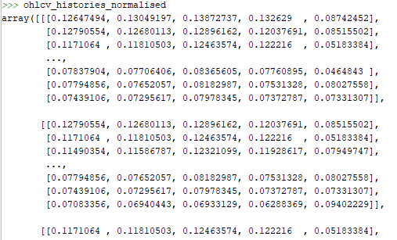
Does forecasting improve the portfolio?
2
Data transformation is still part of the job!
50 days sliding window
50 day sliding window example for RNN model.

Slide 21
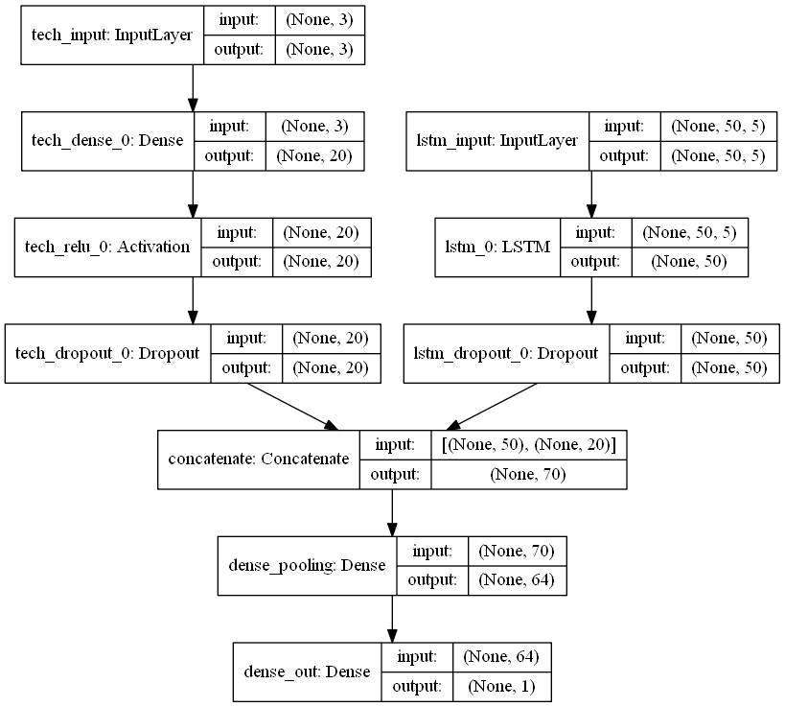
Forecast: Does forecasting improve the portfolio?
2
Using a multi-input model is a good way to improve accuracy!
Model Design:
A multi-input model has been applied using Keras functional API, to include:
historic stock prices (ohlcv)
additional technical indicators e.g. exponential moving average
Keras RNN model.

Slide 22
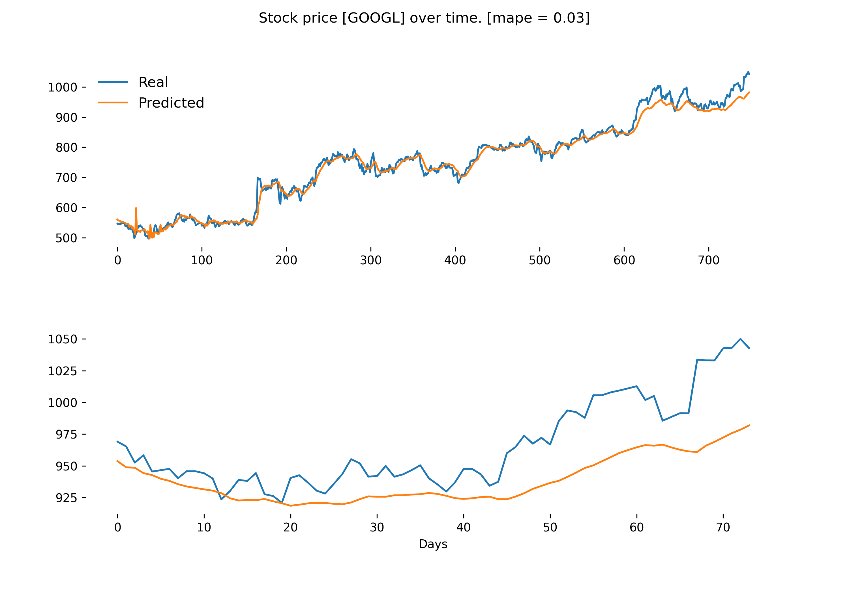
Does forecasting improve the portfolio?
2
Testing your model is still a must when doing forecasting!
Model Evaluation:
Model performance was measured using the mean absolute percentage error (MAPE).
A MAPE value of 0.03 implies that there is a deviation between actual and predicted values of 3%.
RNN model results fit on in-sample and out-of-sample dataset.

Slide 23
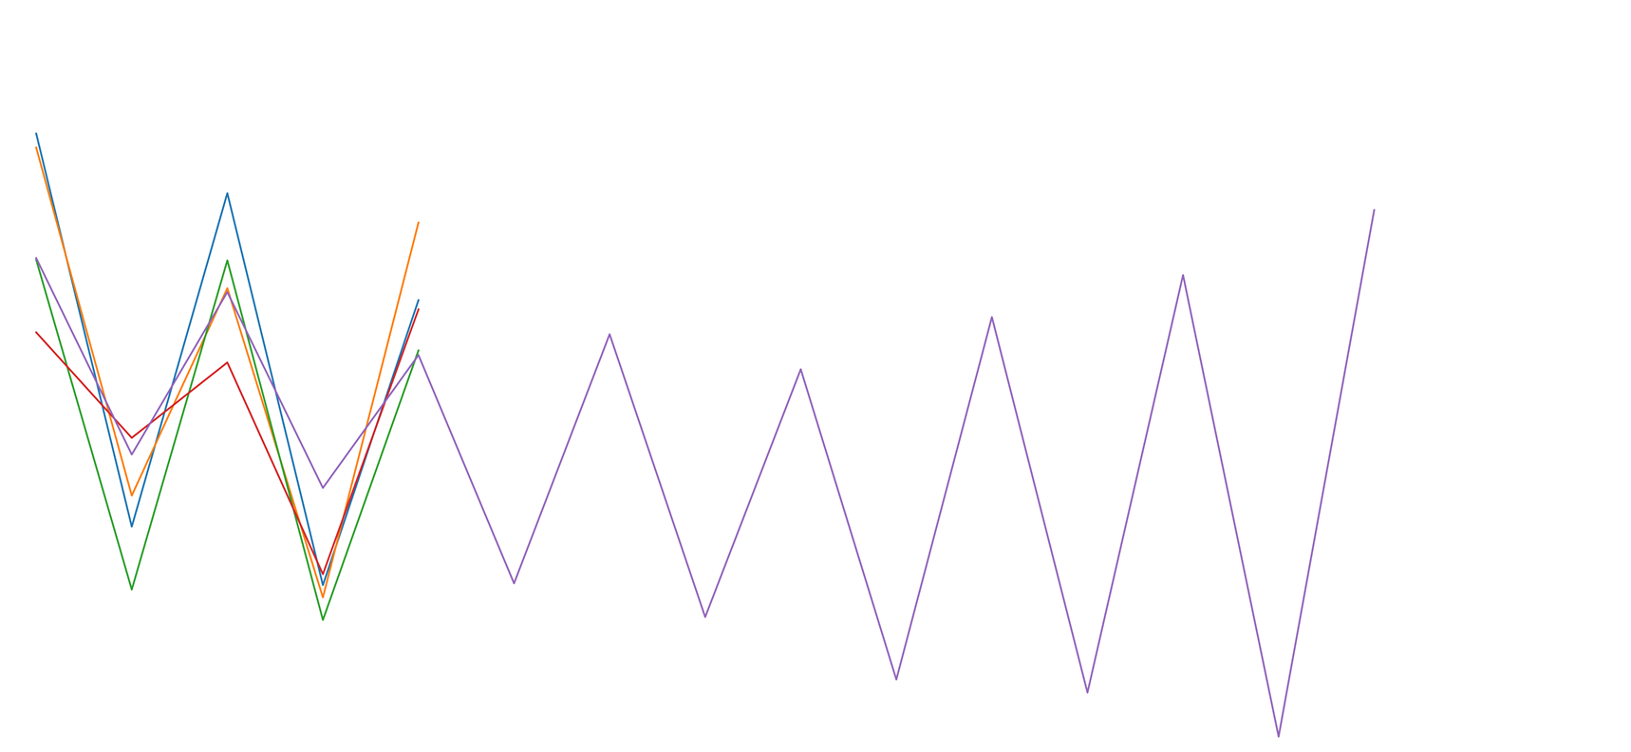
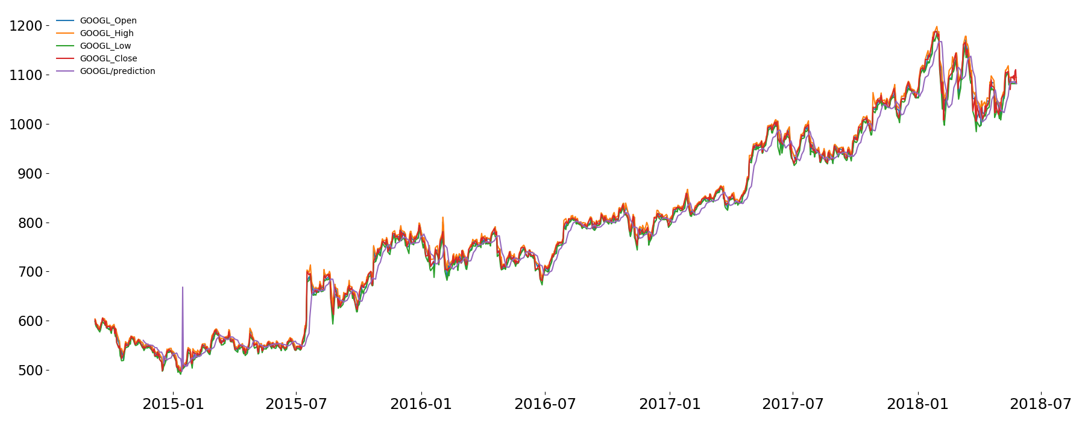
Forecast: Does forecasting improve the portfolio?
2
Don‘t forecast too far. RNNs do a great job at forecasting timeseries data!
RNN model results fit on entire dataset with 10-days out-of-sample forecast.

Slide 24
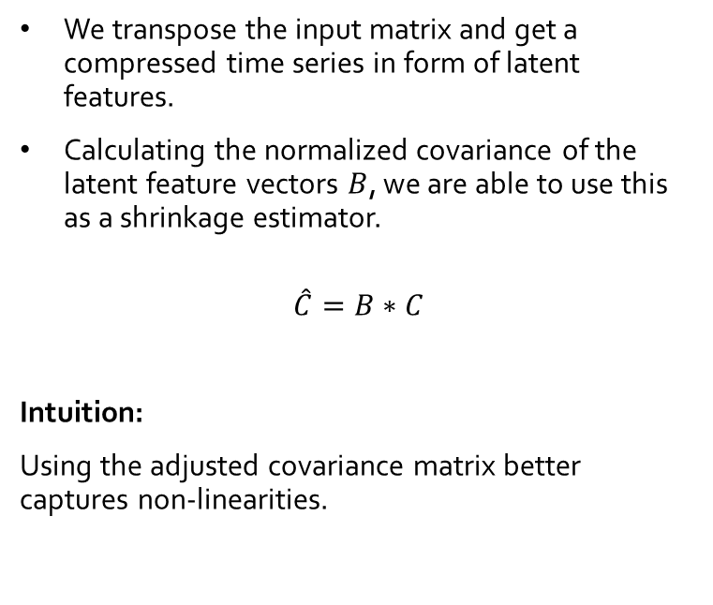
Clean: How to improve the risk calculation of a stock?
3
Latent features catch non-linearities and can be used to improve the sample covariance matrix!
Returns
We transpose the input matrix and get a compressed time series in form of latent features.
Calculating the normalized covariance of the latent feature vectors $B$, we are able to use this as a shrinkage estimator.
$$\hat{C}=B∗C$$
Intuition:
Using the adjusted covariance matrix better captures non-linearities.
Stocks
0.3
0.4
0.1
0.1
0.2
Input Cells
0.1
-2
0.3
Hidden Cells
Calculate normalized covariance matrix of latent features and multiply it with the original covariance matrix
Autoencoder model with calculated covariance of latent features.

Slide 25
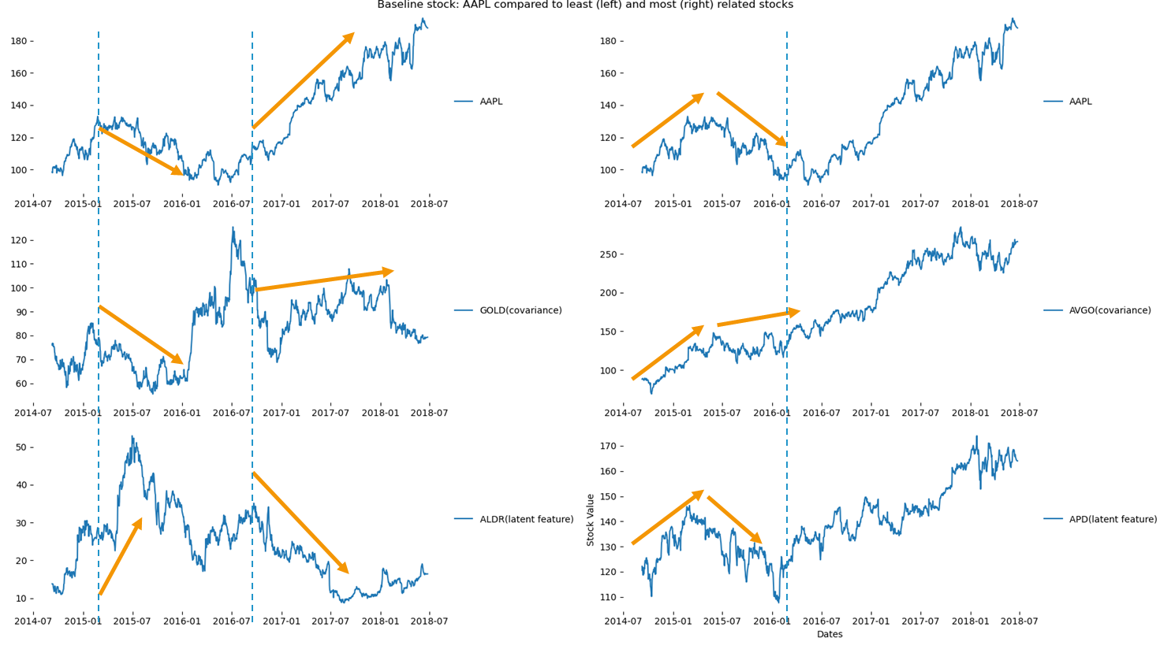
Clean: How to improve the risk calculation of a stock?
3
Latent features catch non-linearities and can be used to improve the sample covariance matrix!
Baseline stock : APPL (Apple) compared to least (left) and most (right) related stocks

Slide 26
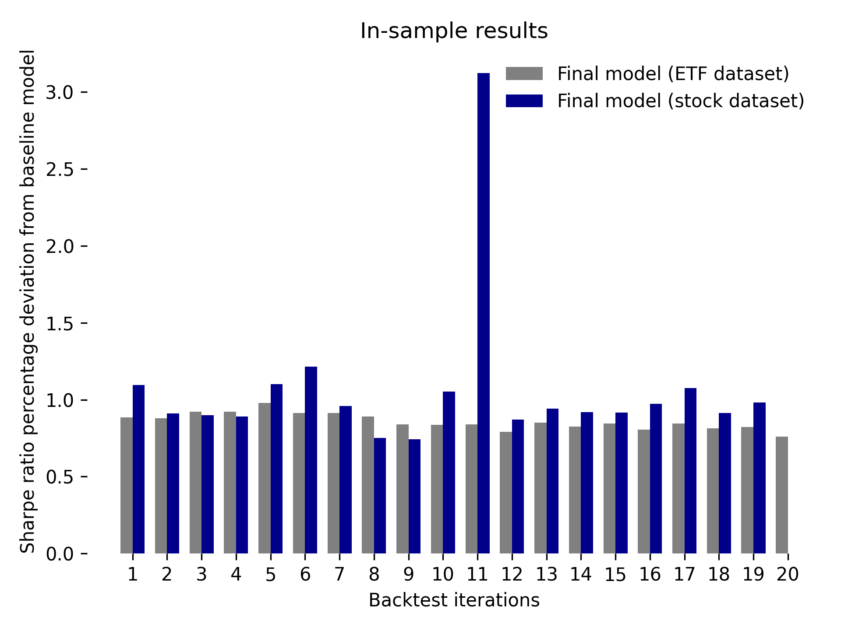
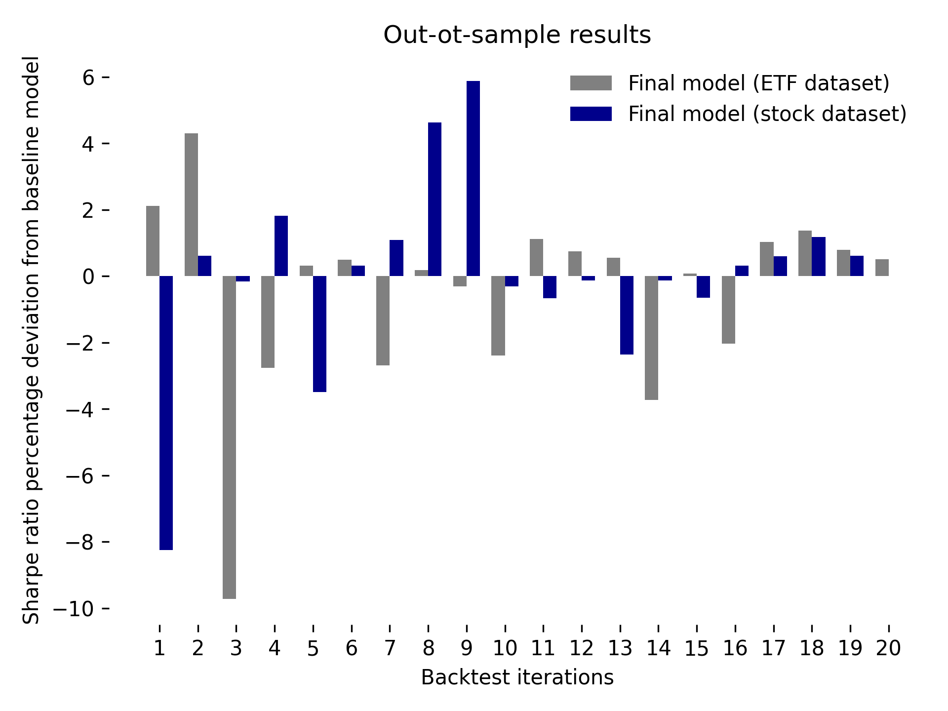
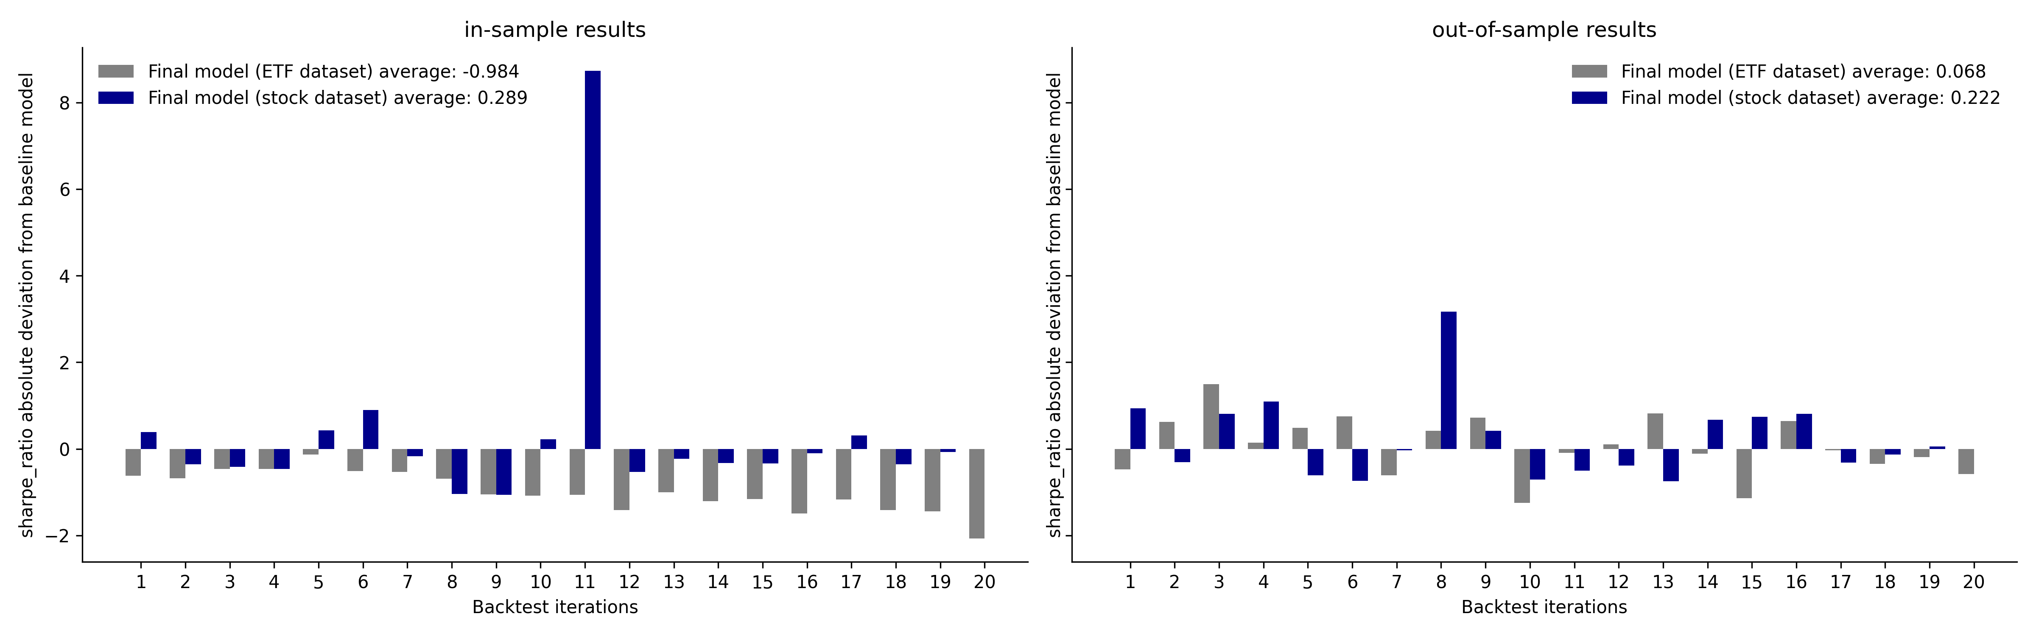
Optimize: How to calculate an optimal portfolio?
2
3
4
In-Sample results look good stocks only, out-of sample results improve the sharpe ratio for both datasets.
In-sample and out-of-sample sharpe ratio deviation for ETFS and stocks
baseline = filtered dataset
challenger = forecasted and cleaned dataset

Slide 27
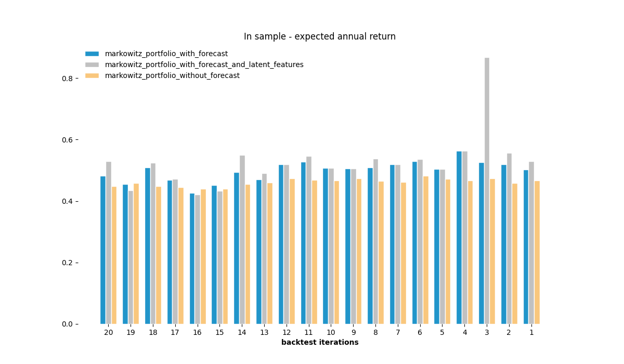
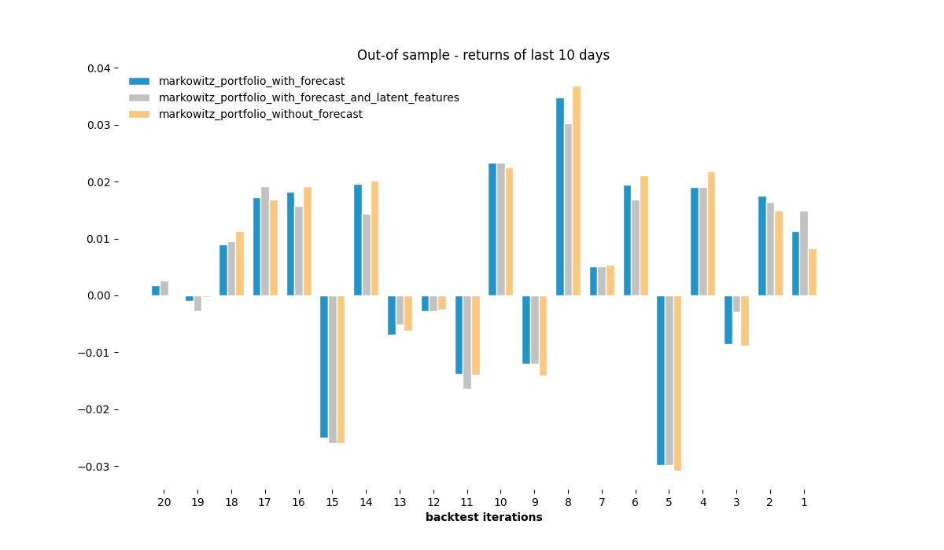
How to calculate an optimal portfolio?
4
In-Sample results look good, out-of sample results do not look indicative.
Expected annual return of Markowitz optimization using different input data (covariance matrix and returns)

Slide 28
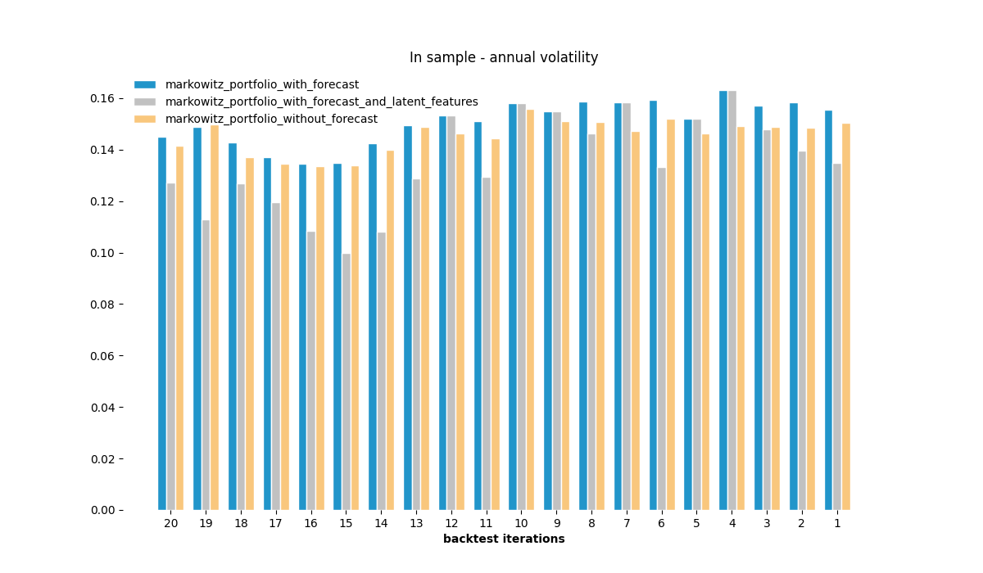
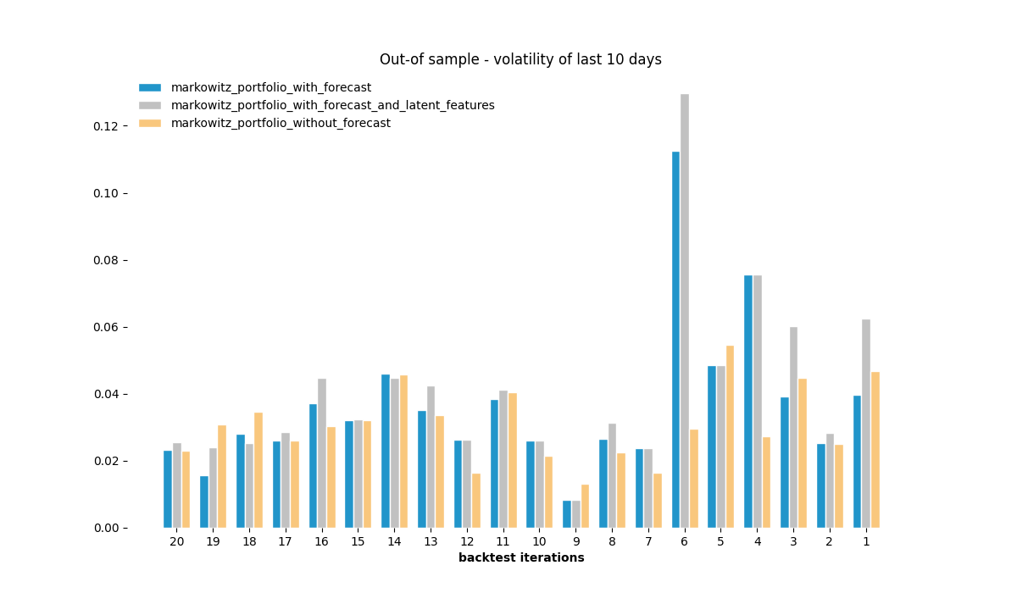
How to calculate an optimal portfolio?
4
Annual volatility of Markowitz optimization using different input data (covariance matrix and returns)

Slide 29
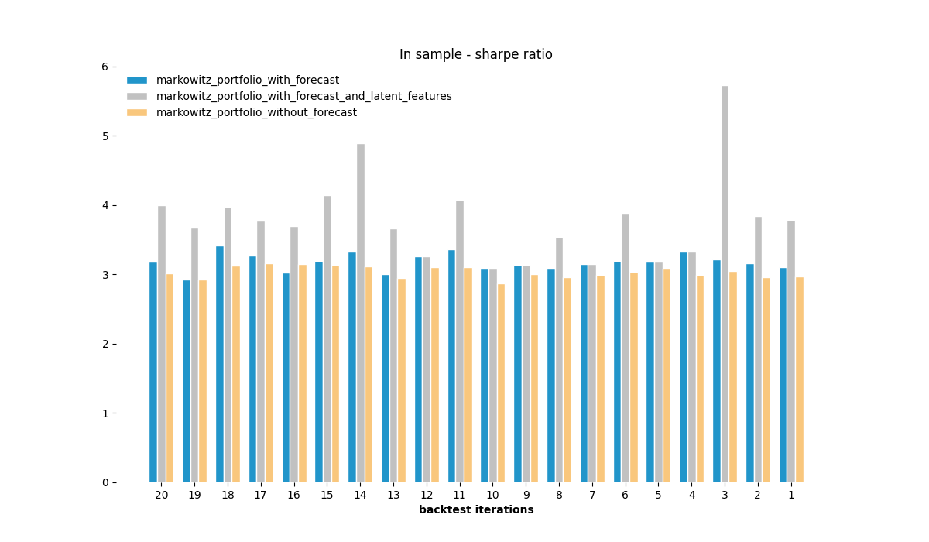
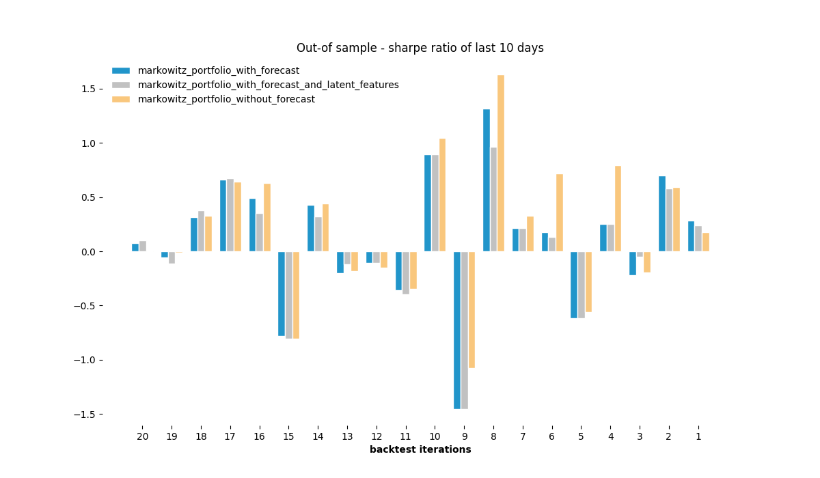
How to calculate an optimal portfolio?
4
Dataset 1 (only stocks). In-Sample results look good, out-of sample results do not look indicative.
Sharpe ratio of Markowitz optimization using different input data (covariance matrix and returns)

Slide 30
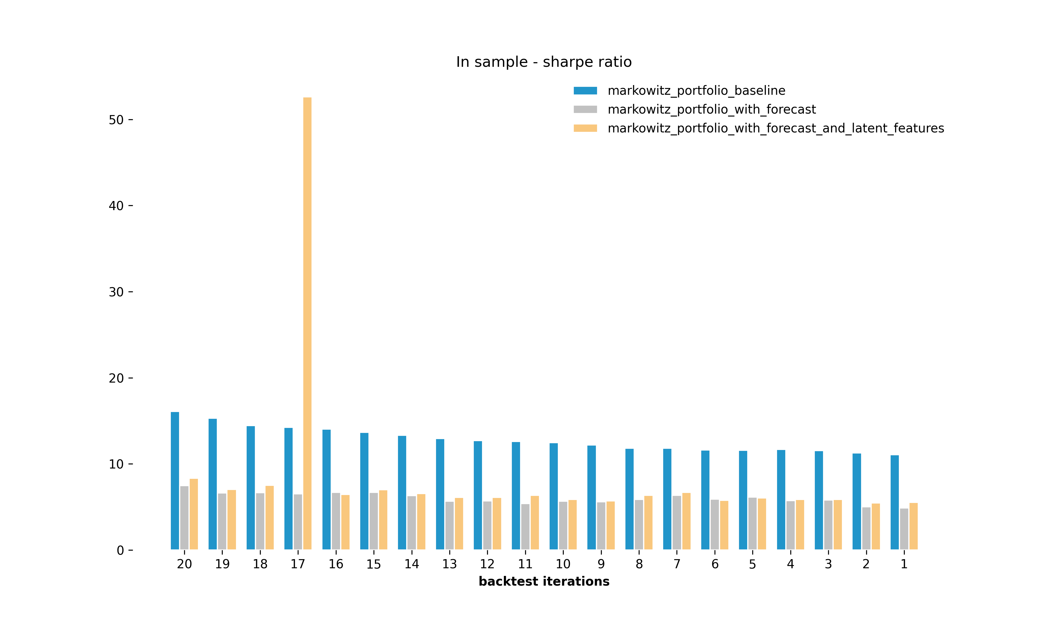
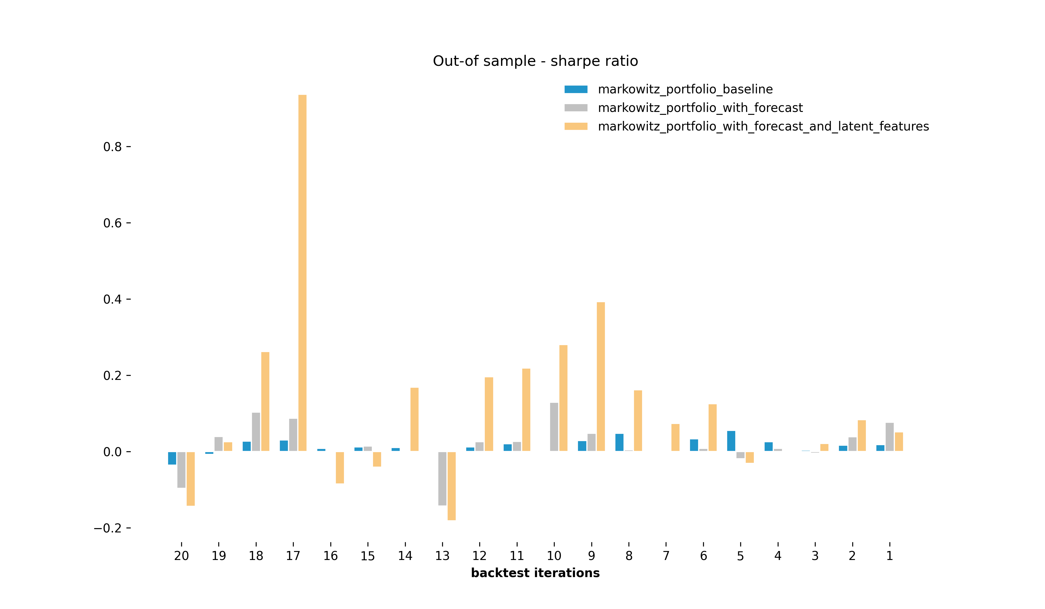
How to calculate an optimal portfolio?
4
Dataset 2 (only ETFs). In-Sample results look good, out-of sample results do not look indicative.
Sharpe ratio of Markowitz optimization using different input data (covariance matrix and returns)

Slide 31
Conclusion and Future Research

Slide 32
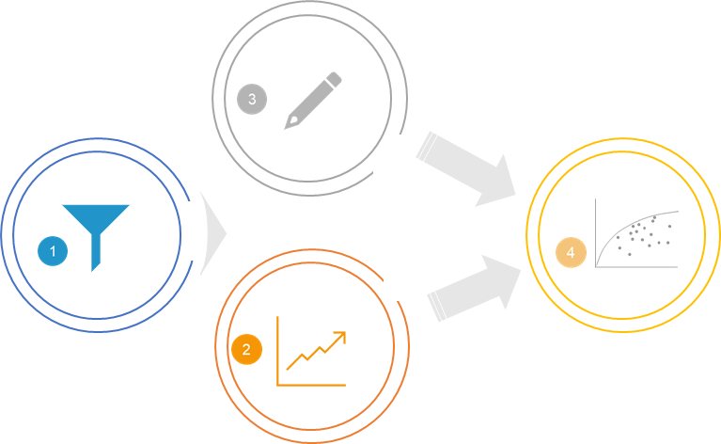
Takeaways
1
Choosing your subset wisely helps to avoid taking a sledgehammer to crack a nut.
2
Don’t forecast too far!
3
Don’t use a linear method on data that is non-linear in nature!
4
Getting the best out-of sample results is a tough nut to crack!

Slide 33
References
J. B. Heaton, N. G. Polson, & J. H. Witte. (2016). Deep Portfolio Theory.
Werbos, P. (1990): Backpropagation Through Time: What It does and How to Do It. https://doi.org/10.1109/5.58337 Retrieved from http://axon.cs.byu.edu/~martinez/classes/678/Papers/Werbos_BPTT.pdf
https://towardsdatascience.com/getting-rich-quick-with-machine-learning-and-stock-market-predictions-696802da94fe
Olivier Ledoit & Michael Wolf, 2003. "Honey, I shrunk the sample covariance matrix," Economics Working Papers 691, Department of Economics and Business, Universitat Pompeu Fabra.

Slide 34
Q & A
Yes, my code is on github!
Add me on LinkedIn!
Looking for a new job?
https://github.com/QUER01/FinanceModule
https://www.linkedin.com/in/julianquernheim/
https://www.bival.de/en/jobs/

Slide 35
Literature Review
Timeline of portfolio selection methods
Heaton et.al
(Deep Portfolio)
Degree of applicability
Ledoit & Wolf, 2003
(Shrinkage)
Black-Litterman
McKibbon
and Rose
(APT)
Markowitz, Sharpe (CAPM)
Markowitz
1952
1964
1973-1976
1991
2002
2016

Slide 36
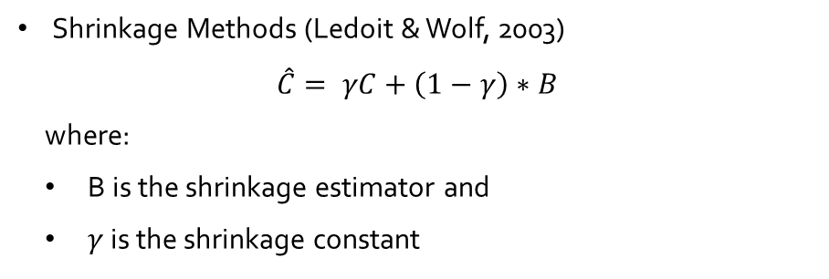
Literature Review
Modern portfolio theory (MPT) (Markowitz, 1952)
Pitfalls of covariance
The covariance indicates a linear relationship between two variables. Hence it can be fallacious in situations where two variables have a relationship, but it is nonlinear.
Covariance is strongly influenced by outliers.
Solutions
Shrinkage Methods (Ledoit & Wolf, 2003)
$$\hat{C}= γC+\left(1−γ\right)∗B$$
where:
B is the shrinkage estimator and
$γ$ is the shrinkage constant
Anscombe's quartet: All four sets are identical when examined using simple summary statistics but vary considerably when graphed.

